Slide 1
DATA SCIENCE Intro to Data Science

Slide 2
I. What Is A Data Scientist? II. Data Science Workflow
AGENDA

Slide 3
I. What is A Data Scientist?
INTRO TO DATA SCIENCE

Slide 4
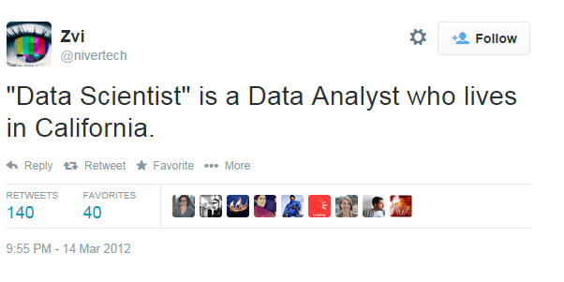
WHAT IS A DATA SCIENTIST?

Slide 5
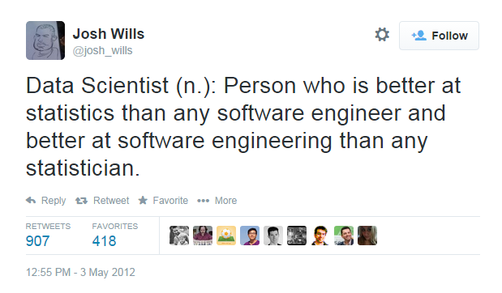
WHAT IS A DATA SCIENTIST?

Slide 6
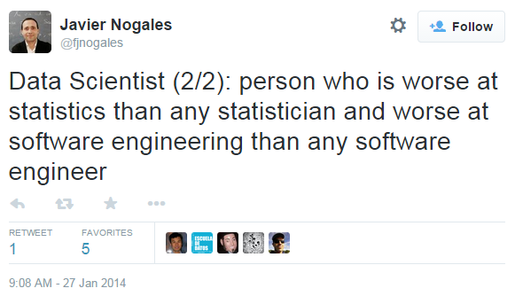
WHAT IS A DATA SCIENTIST?

Slide 7
What Is your definition?
WHAT IS A DATA SCIENTIST?

Slide 8
WHAT IS A DATA SCIENTIST?
“Data Scientists are people with some mix of coding and statistical skills who work on making data useful in various ways.”
Data Scientist Type A (for Analysis):
Primarily concerned with making sense of data or working with it in a fairly static way.
Similar to a statistician, but knows all the practical details of working with data that aren't taught in statistics: data cleaning, dealing with large data sets, visualization, domain knowledge, etc.
Source: https://www.quora.com/What-is-data-science/answer/Michael-Hochster

Slide 9
WHAT IS A DATA SCIENTIST?
“Data Scientists are people with some mix of coding and statistical skills who work on making data useful in various ways.”
Data Scientist Type B (for Building):
Some statistical background, but strong coder or software engineer.
Primarily concerned with using data “in production”: building models which interact with users (by giving recommendations, for example).
Our course is focused primarily on Type A.
Source: https://www.quora.com/What-is-data-science/answer/Michael-Hochster

Slide 10
WHAT IS A DATA SCIENTIST?
Hadley Wickham’s advice for becoming a data scientist:
Statistical knowledge
“I think you need some knowledge of specific statistical/machine learning techniques, but a deep theoretical understanding is not that important. You need to understand the strengths and weaknesses of each technique… The vast majority of data science problems can be solved by a creative assembly of off-the-shelf techniques, and don't require new theory.”
Source: https://gist.github.com/hadley/820f09ded347c62c2864

Slide 11
WHAT IS A DATA SCIENTIST?
Hadley Wickham’s advice for becoming a data scientist:
Programming skills
“You need to be fluent with either R or Python. There are other options, but none of them have the community that R and Python have, which means you'll need to spend a lot of time reinventing tools that already exist elsewhere.”
Source: https://gist.github.com/hadley/820f09ded347c62c2864

Slide 12
WHAT IS A DATA SCIENTIST?
Hadley Wickham’s advice for becoming a data scientist:
Domain knowledge
“…A data scientist should be able to contribute meaningfully to any project, even if you're not intimately familiar with the specifics. I think this means you should be generally well read… and an able communicator. A good data scientist will help the real domain experts refine and frame their questions in a helpful way. Unfortunately I don't know of any good resources for learning how to ask questions.”
Source: https://gist.github.com/hadley/820f09ded347c62c2864

Slide 13
Ii. data Science Workflow
INTRO TO DATA SCIENCE

Slide 14
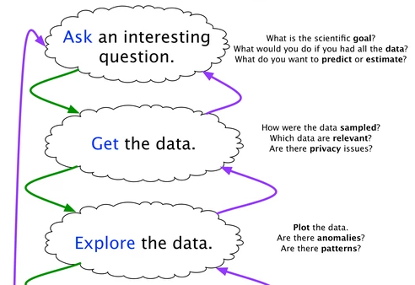
The data Science WORKFLOW

Slide 15
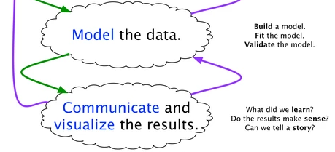
The data Science WORKFLOW
Source: https://www.quora.com/What-is-the-work-flow-or-process-of-a-data-scientist-analyst-and-what-tools-do-you-use-for-this/answer/Ryan-Fox-Squire

